Slide 1
Statistics and Error Analysis (A Variety of Topics Applicable to ASTR 257)

Slide 2
Probability Distribution Functions (PDFs)
Uniform Distribution
Gaussian (or Normal) Distribution
Poisson Distribution
Continuous Distributions:
Integral between two x-values is the probability of falling between two x-values.
Integral of PDF=1
Discrete Distributions:
Value at a given point is probability
Sum of PDF=1

Slide 3
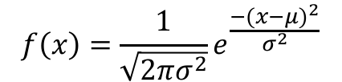
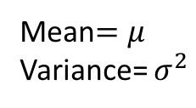
Gaussian Distribution—standard error
$$f\left(x\right)=\frac{1}{\sqrt{2πσ^{2}}}e^{\frac{{−(x−μ)}^{2}}{σ^{2}}}$$
Mean$=μ$
Variance= $σ^{2}$
Outside of photon counting (next slide), this is usually the right one to use. We don’t have time to go into too much detail, but I’d encourage you to look up “Central Limit Theorem”.

Slide 4
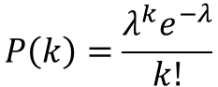
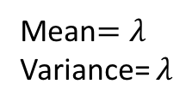
Poisson Distribution—counting error
Error on the number of events
The number of patients arriving in an emergency room between 10 and 11 pm
The number of meteors greater than 1 meter diameter that strike earth in a year
The number of photons that hit a given pixel of your CCD. (NOTE: photons, not counts!)
$$P\left(k\right)=\frac{λ^{k}e^{−λ}}{k!}$$
Mean$=λ$
Variance= $λ$
…becomes Gaussian for large lambda

Slide 5
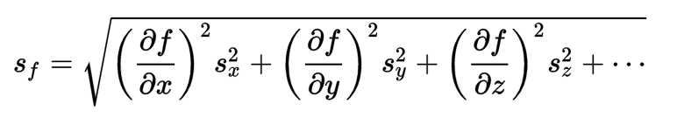
Error Analysis—Propagation of Errors
Standard “Physics Lab” Approach
When calculating a quantity “f” from measurements “x”, “y” and “z”:
…more complicated problems can be evaluated with Monte Carlo simulations, which are outside of the scope of this class

Slide 6
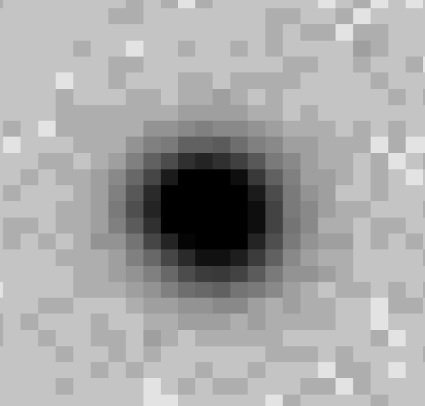
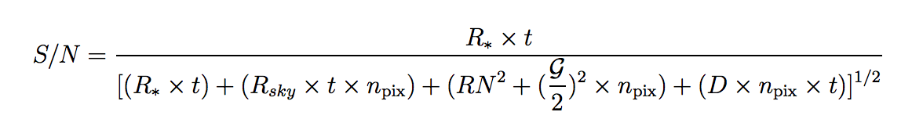
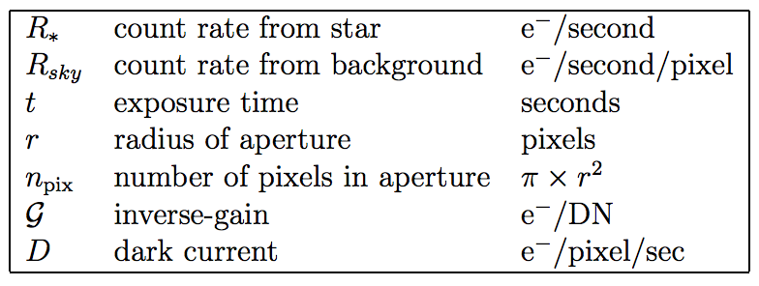
CCD Equation
(
)

Slide 7
CCD Equation
Photons from star
“Signal-to-noise ratio”
RMS
(
)
Poisson noise from photons from star
Poisson noise from sky background
Gaussian read noise
Digitization noise
(ignore—usually tiny)
Poisson noise from dark current

Slide 8
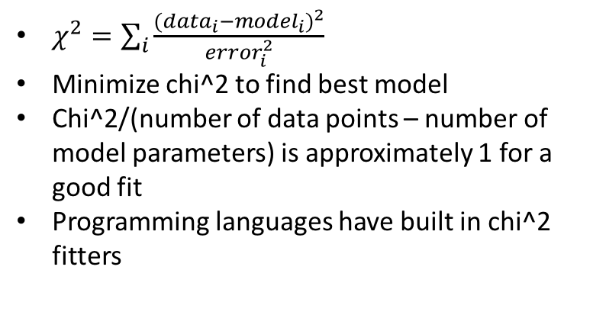
Goodness of Fit—Chi-squared
$χ^{2}=\sum_{i}{\frac{{({data}_{i}−{model}_{i})}^{2}}{{error}_{i}^{2}}}$
Minimize chi^2 to find best model
Chi^2/(number of data points – number of model parameters) is approximately 1 for a good fit
Programming languages have built in chi^2 fitters

